Slide 1
Hiring Process Analytics
Sethuraman B

Slide 2

Project Description
Hiring process is the fundamental and the most important function of a company. Here, the MNCs get to know about the major underlying trends about the hiring process.
You are working for a MNC such as Google as a lead Data Analyst and the company has provided with the data records of their previous hirings and have asked you to answer certain questions making sense out of that data.
You are given a dataset of a company where the details about people who registered for a particular post in a department of this company. You are required to use your knowledge in statistics and use different formulas in excel and draw necessary conclusions about the company.

Slide 3

Tasks
Hiring: Process of intaking of people into an organization for different kinds of positions.
Average Salary: Adding all the salaries for a select group of employees and then dividing the sum by the number of employees in the group.
Class Intervals: The class interval of different employee offered salary bins .
Charts and Plots: This is one of the most important part of analysis to visualize the data.
Charts: Use different charts and graphs to perform the task representing the data.

Slide 4







Hiring: Process of intaking of people into an organization for different kinds of positions.
Your task: How many males and females are Hired ?
Here we have counted the number of event_name according to the conditions given i.e. Hired-Male, Hired
- Female. I have simply used countifs function. For the whole sheet, the value is the same for the new column which is Hiring
Basically here we got an analysis that the Total males hired is 2563 and the total females hired is 1856

Slide 5
Average Salary: Adding all the salaries for a select group of employees and then dividing the sum by the number of employees in the group.
Your task: What is the average salary offered in this company ?
Here we have counted the number of employees (hired + rejected) and then took out a summation of all the salaries of the employees and divide it by the total number of employees. Using the average function we can do this very easily.
Basically after this calculation it found that the average salary of the employees in the company is Rs.49983.03 .

Slide 6
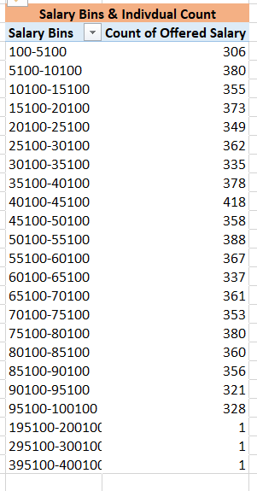





Class Intervals: The class interval Employee Salary Bins
Your task: Draw the class intervals for salary in the company ?
Bin size is 5000 ,and the bin range between 40100-45100 has 418 employee with offered salary

Slide 7
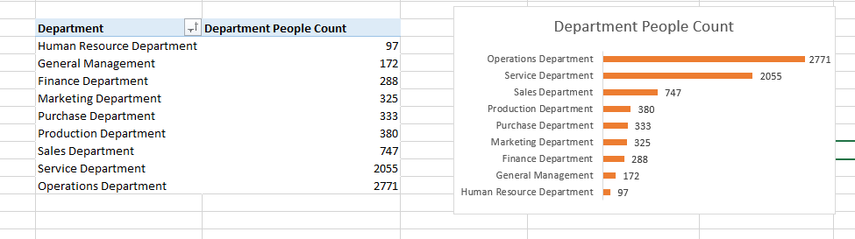



Charts and Plots: This is one of the most important part of analysis to visualize the data.
Your task: Draw Pie Chart / Bar Graph ( or any other graph
) to show proportion of people working different department ?
Here, we have created a pivot table showing the different departments and the count of people in different departments. Then we basically focused on making a chart that visualized the scattered proportion of the people.
Here we can see that the biggest proprtion of the people are there in the Operations Department and Service Departments

Slide 8
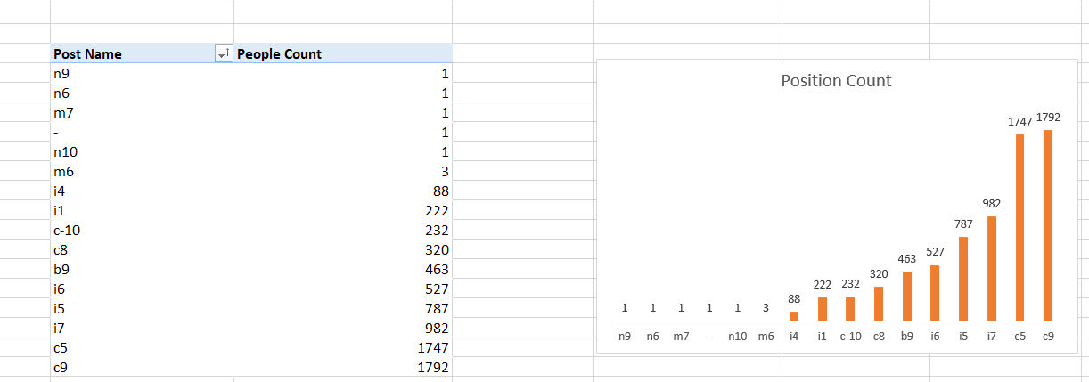


Charts: Use different charts and graphs to perform the task representing the data.
Your task: Represent different post tiers using chart/graph?
Here, we have created a pivot table related to all the post names and counted how many are there in that posts, and eventually created a column chart for the same. And can now clearly see the chart/graph which we can distinguish accordingly.
After the visualization we can see C9 and N9 posts are occupying the majority section of the pie chart.

Slide 9

Result
Learnt EXCEL new terms and methods and many of the new functions. Getting proper insights from the problem statement solving real-world problems.
All the concepts have helped me get a
a deep insight into the problem statement.
This project has helped me to gain confidence in analyzing a problem and eventually to learn the practical use of the concepts taught in the training.
Excel Link: https://docs.google.com/spreadsheets/d/1j03pR2mn5GAUuXHmvhXgGVhtIanSqZUC/edit?usp=sharing&ouid=108433007974397532023&rtpof=true&sd=true
Thank You…!

